Slide 1
Classes
Module 4
Notes:
Version: 12/09/2019 17:55:23

Slide 2
Disclaimer

Slide 3

Objectives
After completing this learning, you will be able to:
Implement classes
Create methods that receive parameters
Create constructors and method overloads
Work with Advanced Object Features
Understand enums

Slide 4
Classes Overview
Custom data types can be created with properties and methods
Create instances of class just like any other data type
PowerShell v5+
Output data in a more professional way than [PSCustomObject]
Differentiate between objects with the same properties
Makes it easier and faster to create multiple copies of custom objects
Enables creation of a suite of tools by standardizing output/input
Ex. *-Service all support returning or receiving [ServiceController] objects
Reusable template across all scripts
Notes:
Another good analogy “A class becomes a template for an object.”

Slide 5
Using a PSCustomObject
PS> $Person = [pscustomobject]@{
Name= "Kory"
Age = 29
Office= "Home"
Title= "PFE"
Planet= "Earth"
Dimension= "c137"
}
PS> $Person.GetType().fullname
System.Management.Automation.PSCustomObject
Inconvenient to reuse / duplicate
PSCustomobject returned, which doesn’t provide much information
Notes:
Another good analogy “A class becomes a template for an object.”

Slide 6
Using a PowerShell Class
PS> $Person = [Person]::new("Kory",29,"home","PFE","Earth","C137")
PS> $Person | Get-Member
TypeName: Person
Name MemberType Definition
---- ---------- ----------
…
Age Property int age {get;set;}
Dimension Property string dimension {get;set;}
Name Property string Name {get;set;}
Office Property string Office {get;set;}
Planet Property string planet {get;set;}
Title Property string title {get;set;}
Concise line to create and easy to reuse
Class Name returned, which can provide more information
Notes:
Another good analogy “A class becomes a template for an object.”

Slide 7

Demonstration
Classes Introduction

Slide 8

Questions?

Slide 9
Class Basics

Slide 10

Class Syntax - Basics
2
1
Class Person
{
[string] $Name
[int32] $Age
[string] $Office
[string] $Title
[String] SaySomething()
{
return "Something!"
}
}
PS> $Person = [Person]::new()
PS> $Person.SaySomething()
Something!
3
Class Keyword
Class Name
Curly Brace Pair
Properties
Methods
4
5
3

Slide 11
Class Syntax - Members
Functions inside the object
No Param() statement
Must use Return to pass out data
Must strongly type return data (default is [void])
Methods
Information to be stored in the object
Created like variables
Properties
Strongly type data (default is [Object])
Class Person
{
[string] $Name
[int32] $Age
[string] $Office
[string] $Title
[String] SaySomething()
{
return "Something!"
}
}
PS> $Person = [Person]::new()
PS> $Person.SaySomething()
Something!

Slide 12
Creating an Instance of your Class
New-Object
$Person = New-Object -TypeName Person
$Person.name = "Kory"
$Person.age = 28
Typecast A Hash Table
$Person = [Person]@{
name = "Kory"
age = 28
}
Default Constructor
$Person = [Person]::new()
$Person.name = "Kory"
$Person.age = 28
Custom Constructor
$Person = [Person]::new("Kory", 28)

Slide 13
Demonstration
Class Basics

Slide 14
Questions?

Slide 15
Doing More With Methods

Slide 16
Methods
Instances call methods via dot notation
Can have parameter sets, called overloads
Can optionally return data
Can receive parameters

Slide 17
Methods with Parameters
Param() is not allowed in a class method
List parameters inside the parenthesis next to the name
[String] SaySomething($Something)
{
return "$Something!"
}
Supports strong typing, which will be reflected in the syntax
[String] SaySomething([String]$Something)
{
return "$Something!"
}
Instances use with dot notation, just like any other object
PS> $Person.SaySomething("That was so funny")
That was so funny!

Slide 18
Overloading a Method
Like parameter sets on functions
Multiple methods with the same name
Useful when they do the same action, but can receive different parameters
[String] SaySomething($Something)
{
return "$Something!"
}
[String] SaySomething()
{
return "Something!"
}
PS> $Person.SaySomething()
Something!
PS> $Person.SaySomething("That was so funny")
That was so funny!

Slide 19
$This
Variable used in classes to interact with its’ own members
Contains the instance of the object that is running the method
Prevents duplicate code in method overloads by calling other methods
Used to access or change properties from a method

Slide 20
Overloading Issues
Both versions of SaySomething() perform the same action, but with different input
Copy & pasted code is cumbersome and hard to edit
Editing behavior involves changing every overload
[String] SaySomething($Something)
{
return "$Something!"
}
[String] SaySomething()
{
return "Something!"
}
PS> $person.SaySomething()
Something!
PS> $person.SaySomething(“Hello World!")
Hello World!

Slide 21
Overloading Issues Fixed
$This allows calling other methods to prevent copying code
Provides one place to edit, with each overload only holding unique code before calling another
Overloads with the least arguments should call one with the most arguments
[String] SaySomething($Something)
{
return "$Something!"
}
[String] SaySomething()
{
return $this.SaySomething("Something")
}
PS> $person.SaySomething()
Something!
PS> $person.SaySomething(“Hello World!")
Hello World!
Notes:
Generally it makes sense to have the methods with the least parameters call the overloads with the most parameters while passing along default values.

Slide 22
Accessing Properties From Methods
$Age doesn’t exist inside of the method
$This.Age can access the property of the object itself
GrowOlder() has void output
$This used in the GrowOlder() Method changes the Age property
Class Person
{
[int]$Age
[void] GrowOlder([int32] $Years)
{
$This.Age += $Years
}
}
PS> $Person.Age = 28
PS> $Person.GrowOlder(10)
PS> $Person.Age
38
PS> $Person.GrowOlder(10)
PS> $Person.Age
48
Notes:
$Age doesn’t exist inside of the method, but $This.Age can access the property of the object itself

Slide 23
Demonstration
Creating Class Methods

Slide 24
Questions?

Slide 25
Advanced Class Features

Slide 26
Classes – Advanced features
Constructors allow creating a class with properties pre-defined
Static and Hidden members can be created
Enums can be used for friendly names on pre-defined values
Classes can inherit members from other classes for modification
Best practice: when using classes declare them in a separate files

Slide 27
Constructors
Method called to create an object
Defined Name must match class name, with no specified return type
Default takes in no params and sets no values
Overloads allowed to provide different creation methods
Called with [CLASS NAME]::new()
PS> [person]::new()
PS> $person.name = "Kory"
PS> $person.age = 28
PS> $Person = [Person]::new("Kory", 28)

Slide 28
Constructor Overloads
Can take in parameter values to define properties on creation
Overloaded like methods
Use $This to set the properties
Person()
{
$this.Name = "Kory"
$this.Age = 28
}
PS> $person = [person]::new()
PS> $person
Name Age
---- ---
Kory 28
Person ([String] $Name, [int32] $Age)
{
$this.Name = $Name
$this.Age = $Age
}
PS> $person = [person]::new("Jeff",27)
PS> $person
Name Age
---- ---
Jeff 27

Slide 29
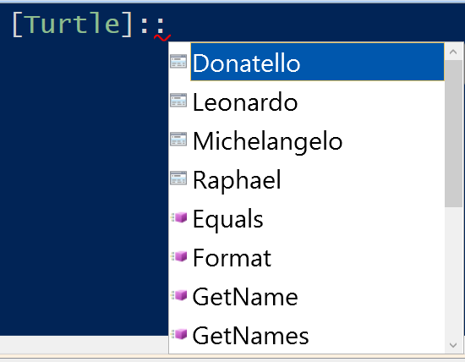
Enums
Enum Turtle
{
Donatello
Leonardo
Michelangelo
Raphael
}
Strongly typed set of labels
Used for pre-defined values with friendly names
Helpful to stay organized with class members
Assigned integer values behind the scenes
Notes:
Take a look at the ENUM example to show using the enums as strong types and errors

Slide 30
Enums Example
Enum Turtle
{
Donatello
Leonardo
Michelangelo
Raphael
}
function TurtlesInTest
{
param([turtle]$Turtle)
Switch($Turtle)
{
…
}
}
PS> TurtlesInTest -Turtle 'Shredder'
Cannot process argument transformation on parameter 'Turtle'. Cannot convert value "Shredder“ to type "Turtle". Error: "Unable to match the identifier name Shredder to a valid enumerator name. Specify one of the following enumerator names and try again: Donatello, Leonardo, Michelangelo, Raphael"
Notes:
Take a look at the ENUM example to show using the enums as strong types and errors
Enum Turtle
{
Donatello
Leonardo
Michelangelo
Raphael
}
function Turtles_in_Test
{
param([turtle]$Turtle)
switch($Turtle.value__)
{
0 {write-host "It's pizza time!" -foregroundcolor Magenta}
1 {write-host "It's pizza time!" -foregroundcolor Cyan}
2 {write-host "It's pizza time!" -foregroundcolor DarkYellow}
3 {write-host "It's pizza time!" -foregroundcolor Red}
}
}
Turtles_in_Test -Turtle "Raphael"
Turtles_in_Test -Turtle "Shredder“

Slide 31
Demonstration
Advanced Features

Slide 32
Using Classes Across Tools
Don’t copy & paste classes or enums into your projects
Best practice is to keep code in its own file and reuse across your scripts
Dot-Source files from scripts that need to use the classes
. $PSScriptRoot\Myperson.PS1
$Person = [Person]::new("Kory",29)
Notes:
This is the same as best practice for function toolboxes should be (or make a module!)

Slide 33
Inheritance
Create new classes that reuse, extend, and modify another class (base class)
Foundation of .NET object-oriented programming [System.Object]
Syntax – Class NewClass : BaseClassName
New class retains all properties and methods, but only default constructor
Class Vehicle {
[int] $Wheels
[ConsoleColor] $Color
[string] $model
Drive(){
Write-Host "Vroom Vroom"
}
}
Class Car : Vehicle {
[int] $Doors
car(){$This.Wheels = 4}
}
PS> [car]::new()
Doors Wheels Color
----- ------ -----
0 4 Black
Notes:
Most basic stuff is going to show System.Object, but this can show base types for different existing data types they might be used to seeing.
[math],[DivideByZeroException],[XML],[long],[alias] | select basetype

Slide 34
Inheritance Example PS 7+
Class ValidationTest : System.Management.Automation.IValidateSetValuesGenerator {
[String[]] GetValidValues() {
return "PowerShell","PS","PShell"
}
}
Function Test-Validation
{
param([ValidateSet([Test])]$Param)
Write-Host $Param -ForegroundColor Green
}
MyFunction -Param PowerShell
Notes:
Example of where inheritance to know about with existing classes
This only works on PS 7+
Allows reusing validate sets across functions to avoid duplicating code

Slide 35
Demonstration
Inheritance

Slide 36
Questions?

Slide 37

PowerShell Classes
60 minutes

Slide 38
Microsoft

Slide 39
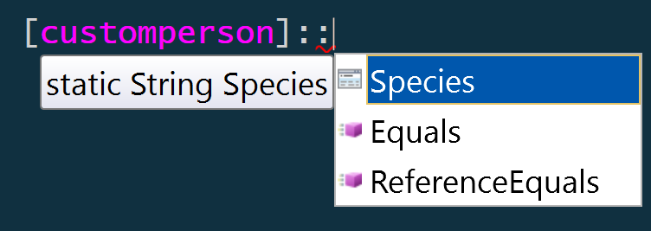
Static members
Live on the type itself
Properties that never change
Methods that don’t need $This
Instances need to use $Data::Property, not $Data.Property
class person
{
…
# Static Properties
static [string] $Species = "Totally real human"
…
}
[person]::Species
> Totally real human
Notes:
Properties that don’t change – would be if you made an object like a bicycle and wanted to the number of wheels. It will always be 2 otherwise it’s a unicycle or tricycle. This matters if you create like 1,000 of them because you can use 1 piece of memory instead of 1,000+
We can’t leverage $this, because it isn’t part of an instance it is actually just a single, unchanging piece of memory for quick access and efficiency.
Useful for creating a static toolbox like [math], such as [math]::Pi or [Math]::Round()
Get-member:
[person] | gm -static

Slide 40
Hidden Members (Continued)
$person | GM -Force
Name MemberType
---- ----------
pstypenames CodeProperty
psadapted MemberSet
psbase MemberSet
psextended MemberSet
psobject MemberSet
Equals Method
GetHashCode Method
GetType Method
get_Age Method
get_Name Method
get_RealSpecies Method
SaySomething Method
set_Age Method
set_Name Method
set_RealSpecies Method
ToString Method
Age Property
Name Property
RealSpecies Property
Default hidden PS members
$person | GM
Name MemberType
---- ----------
Equals Method
GetHashCode Method
GetType Method
SaySomething Method
ToString Method
Age Property
Name Property
Auto Generated hidden methods
Our hidden Property

